Slide 1
UPE Tutoring:
CS 32 Project 3 Hack
Sign-in https://bit.ly/39sW7vD
Slides link available upon sign-in

Slide 2
Quick Announcement - CS Town Hall
Date & Time: Wed, Feb 26th 6-8 pm (Week 8)
Location: Mong Auditorium, Eng VI
The CS Town Hall is an opportunity for all students in CS and related disciplines to interact with the UCLA CS Department and provide feedback, suggestions or discuss problems.
Please make your voice heard! Fill out this survey: https://forms.gle/JrE9HYXmwftrYB6NA
This year, we will also have a discussion about cheating in CS classes. Voice your opinion in this completely anonymous survey: https://forms.gle/KuRKjmfWqJZp8xix5
Food will be provided! RSVP Link: https://www.facebook.com/events/528498164437871/
Notes:
Refer to the template for the original slide - Lily

Slide 3
To ease your nerves… (tips and advice)
The spec might look very long and intimidating, but it is actually very useful because:
Some parts sound redundant; this implies using inheritance / a common base class
Very detailed, so what you need to code is very clear; just translate English to code
START EARLY! DON’T PROCRASTINATE
Develop incrementally; code one feature at a time, then compile and test it
Backup your code after each working feature gets implemented (github or Google Docs)
Don’t procrastinate! Catching up will be very stressful.
START EARLY! Stop thinking about it, just DO IT!
If you still have questions about game logic and implementation that the spec doesn’t answer, refer to the example programs
This project teaches Object-Oriented Programming, the most important skill you’ll ever learn and the skill you’ll use most if you’re planning to work in industry!

Slide 4
Overview of Project

Slide 5
Kontagion: Brief Summary
2D game (that is very hard to play)
Setting: Circular Petri dish / arena, nothing can be outside specified radius
Goal: kill all bacteria that are spawned from bacterial pits on the level, go to next level
Objects in the game:
Player: Socrates Nguyen
Can only move around perimeter of circle
3 lives total
Projectiles: flame and disinfecting spray
Bacteria: 3 types that range from not aggressive to very aggressive
Goodies (power ups): 3 types that update Socrates’ stats in a positive way
Harmful goodie: Fungus, deals 20 points of damage to Socrates
Other actors: Bacterial pits, Dirt piles, Food

Slide 6
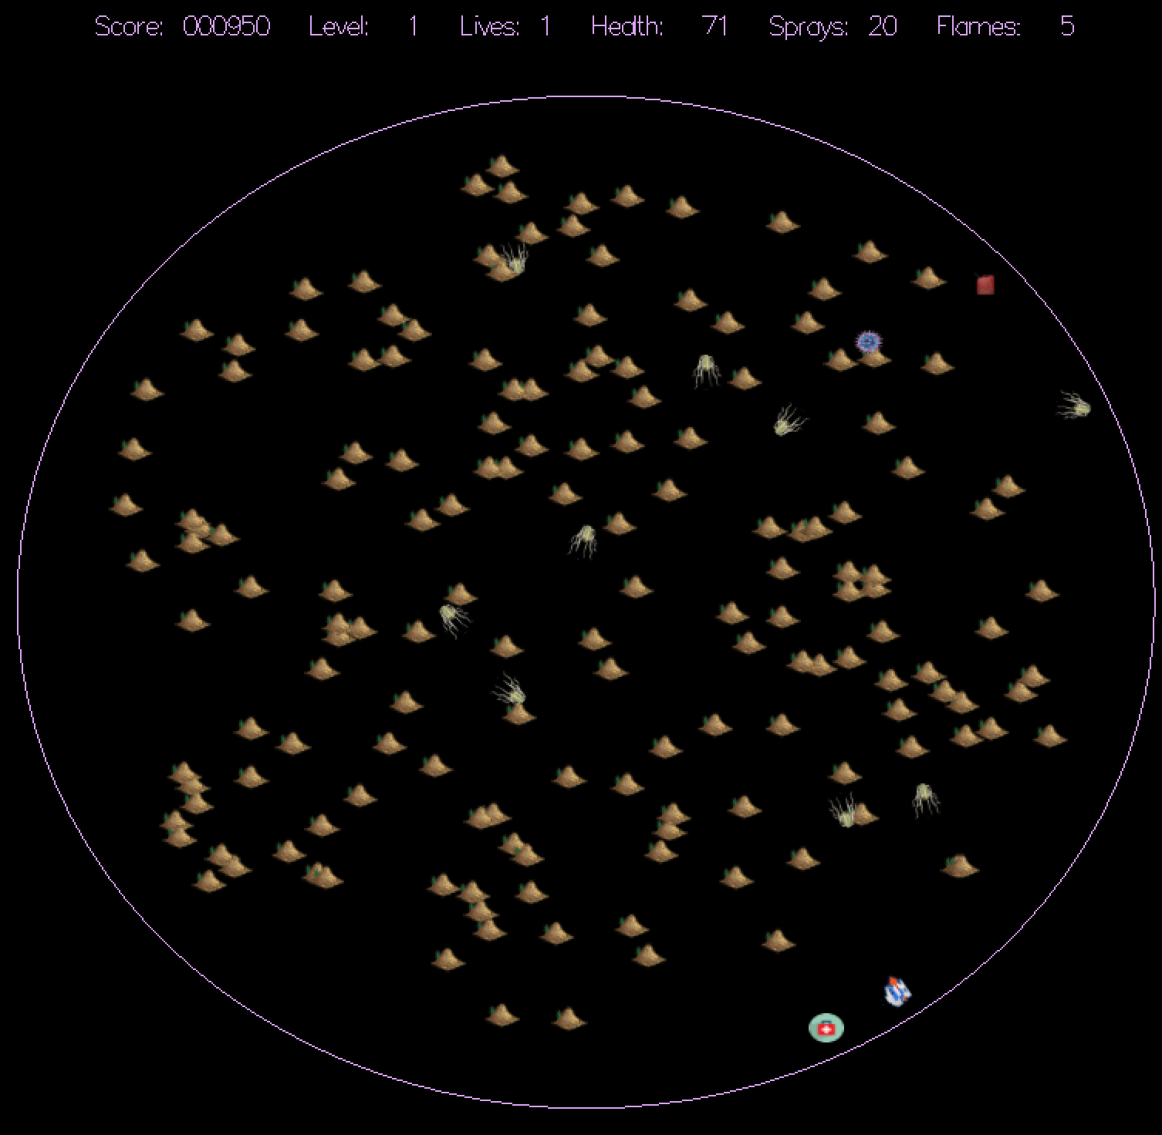

Slide 7
List of All Game Objects
Refer to page 21 of the spec
Socrates
Regular Salmonella bacteria
Aggressive Salmonella bacteria
Very aggressive E. coli bacteria
Flame projectiles
Spray projectiles
Dirt piles
Food
Bacterial pits
Restore health goodies
Flame thrower goodies
Extra life goodies
Fungi

Slide 8
Actors
Game Objects are called Actors
Each ‘tick’ of the game, all of the Actors have to ‘doSomething’
They move around, cause damage, grant bonuses, die, etc.
Each ‘tick’, the “dead” Actors should be removed
A class called StudentWorld manages all of these ‘ticks’ and Actor interactions
Project Goal: Implement all of the Actors and the StudentWorld

Slide 9
Getting Started
From the CS 32 website:
Read the spec (54 pages! :D watch out for the occasionally funny bits)
Download the skeleton code zip
Play through the example games
Do the Project 3 Warmup to get some experience with STL containers and iterators
Re-read the spec as necessary
Make sure you know how to compile and run your code

Slide 10
Project Structure
Many files in the skeleton code, but we are only interested in some of them!
Files of Interest:
Need to modify:
Actor.h/cpp
StudentWorld.h/cpp
Leave as is, but good to understand:
GameConstants.h
GameWorld.h/cpp
GraphObject.h
main.cpp (but you do need to set Assets string)

Slide 11
Project Structure: GraphObject Class
GraphObject(int imageID, double startX, double startY,
int startDirection = 0, int depth = 0);
Responsible for drawing all of the game objects at their (x, y) location
Upon every instantiation of a GraphObject (including its derived classes), the provided code will display the appropriate image (according to its imageID) at (startX, startY)
You MUST derive all of your game objects directly or indirectly from GraphObject
Useful GraphObject functions (spec p. 22) for Part 1:
double getX(); double getY();
void moveTo(double x, double y); void moveAngle(Direction angle, int units = 1);
void getPositionInThisDirection(Direction angle, int units, double& dx,double& dy);
int getDirection(); void setDirection(Direction d);

Slide 12
Project Structure: GameWorld
Controls the gameplay
Keeps track of levels, lives, score
Gets player input to move Socrates
Plays sounds for various gameplay events
Sets the game status text
You MUST create StudentWorld, which is derived from GameWorld
Part 1: Implement at least private data members, init(), move(), cleanup(), constructor, destructor
Useful GameWorld functions for Part 1 (spec p. 15): (you do need to use this one)
bool getKey(int& value);

Slide 13
Part 1
To do: (spec p. 50)
Base class for all Actors (simplified)
Dirt pile class
Socrates class (simplified)
StudentWorld class (simplified)
Due Week 7 Thursday
Feb 20, 11 pm
Notes:
Nikki’s part to slide 21

Slide 14
Part 1: Base Actor Class
Create a base class from which all other game object classes will derive
This base class must derive from GraphObject
The constructor must initialize the object appropriately
It must have a doSomething() function
Add any public/private member functions and any private data members you need
What common functionality or attributes do all Actors have or need?
Which functions should be virtual? or pure virtual? Will this class ever be instantiated?
Recommendation: Start with this class

Slide 15
Part 1: Dirt Pile Class
Dirt piles can be derived from the base class
Details (spec p. 27):
When first created:
Image ID: IID_DIRT
Location: Random, as specified in StudentWorld::init() section (p. 18)
Direction: 90 degrees
Depth: 1
Life: Initially alive; does not have hit points
During a tick (doSomething())
Does nothing!
Other:
Blocks bacteria, spray, flames; dies from contact with spray or flames

Slide 16
Part 1: Socrates Class
Socrates can be derived from the base class or from other derived classes
Details (spec p. 25):
When first created:
Image ID: IID_PLAYER
Location: Positional angle of 180 degrees in Petri dish, so X = 0, Y = 128
Direction: 0 degrees (to the right)
Depth: 0
Life: Initially alive, with 100 hit points (health)
Weapon charges: 20 spray, 5 flame thrower

Slide 17
Part 1: Socrates Class (simplified doSomething())
Details (spec p. 25):
During a tick:
If Socrates is not alive, return immediately (not a specific Part 1 requirement)
Get user input; if player pressed a key, perform the desired action
If directional keys: move Socrates by 5 degrees in positional angle either clockwise or counterclockwise, and set the direction he is facing
Other keys (space to use spray, enter to use flamethrower): not Part 1 req
If player DID NOT press key: (not Part 1 req)
Replenish spray charges by 1 (if not already at maximum of 20 charges)

Slide 18
Part 1: Socrates Class (Object-Oriented Programming)
But how can we check user input?
How can Socrates get access to the GameWorld::getKey(int& value)?
StudentWorld derives from GameWorld
StudentWorld creates Socrates
Is Socrates aware of StudentWorld? Is StudentWorld aware of Socrates?
If they are aware of each other, who initiates an action to change the state of the other?
THIS is quite an important dilemma in object-oriented programming
Refer to the spec’s Object Oriented Programming Tips (p. 45) for more info
(Think back to Project 1, with the Arena and its Vampire and Player objects)

Slide 19
Part 1: StudentWorld Class (simplifed)
Add private data members to keep track of all game objects (Actors and Socrates)
Part 1: will only be keeping track of dirt and Socrates for now
Constructor: initializes data members
init() (p. 16)
This method is called at the beginning of each new level
Allocates/initializes Socrates and all other Actors (for Part 1, just Dirt)
Refer to page 18 for details about how to initialize the Actors
move() (p. 17-20)
Call doSomething() for every Actor (Socrates, Dirt, etc.)
Then delete dead Actors, add new Actors, update game status text (not Part 1)
cleanUp() and Destructor (which can call cleanUp()) (p. 21)
Delete any remaining dynamically allocated game objects

Slide 20
How to keep track of your Actors
“It is required that you keep track of all of the actors (e.g., bacteria like aggressive salmonella, pits, foods, projectiles like spray, goodies, etc.) in a single STL collection such as a list, map or vector. (To do so, we recommend using a container of pointers to the actors). If you like, your StudentWorld object may keep a separate pointer to Socrates object rather than keeping a pointer to that object in the container with the other actor pointers; Socrates is the only actor pointer allowed to not be stored in the single actor container.” - The Spec, page 16
What STL container do you want to use for your Actors?
Project 3 Warmup can guide you
So can Carey’s glorious slides about STL containers

Slide 21
Reminders about Iterator Shenanigans
Deleting dead actors will require iterating through the STL container and only erasing a few of the items
Thus, we need to use the return value of erase() which is an iterator to the next element after the deleted element
These examples show how to erase all elements in a vector
What happens if we only want to erase some elements from the STL container?
BAD: it will be invalidated
vector<int> v{ 1 , 2 , 3 };
vector<int>::iterator it;
for (it = v.begin(); it != v.end(); it++)
v.erase(it);
BETTER: erase() returns a valid iterator which is basically it++
vector<int> v{ 1 , 2 , 3 };
vector<int>::iterator it;
for (it = v.begin(); it != v.end(); ) // notice: no it++
it = v.erase(it);

Slide 22
Reminders about Iterator Shenanigans
When erasing only some items, make sure not to accidentally skip elements!
These examples are with a STL list, but for all STL containers we should use the return value of erase()
BAD: it++ will cause elements to be skipped
void eraseOnlyZeroes(list<int>& x) {
list<int>::iterator it = x.begin();
for ( ; it != x.end(); it++) {
if (*it == 0)
it = x.erase(it);
}
}
BETTER: only increment it when we DO NOT erase
void eraseOnlyZeroes(list<int>& x) {
list<int>::iterator it = x.begin();
for ( ; it != x.end(); ) { // notice: no it++
if (*it == 0)
it = x.erase(it);
else
it++;
}
}

Slide 23
Part 2
Implement everything in the spec to create a fully working game
Files you need to complete:
Actor.h/cpp
StudentWorld.h/cpp
And a report
Don’t overdo the detail
After turning in Part 1, the CS 32 website will update with resources discussing possible designs
Good luck and have fun!
Due Week 8 Thursday
Feb 27, 11 pm
Notes:
Lily’s part to the end

Slide 24
Object-Oriented Design Tips

Slide 25
Polymorphism and Inheritance
Although it is a long spec, a lot of it is repetitive
Take the “subtle” hint!! - Use polymorphism and inheritance!
FLIP BACK AND FORTH BETWEEN THE NEXT TWO SLIDES
TO SEE FOR YOURSELF

Slide 26
copied straight from the spec
What a Regular Salmonella Must Do During a Tick
Each time a regular salmonella is asked to do something (during a tick):
The regular salmonella must check to see if it is currently alive. If not, then its doSomething() method must return immediately – none of the following steps should be performed.
The regular salmonella must check to see if it overlaps¹¹ with Socrates. If so it will:
Tell Socrates that he has received 1 point of damage.
Then skip to step 5.
The regular salmonella will see if it’s eaten a total of 3 food since it last divided or was born. If so:
It will compute a newx coordinate, equal to its own x coordinate:
Plus SPRITE_RADIUS if its x coordinate is < VIEW_WIDTH/2
Minus SPRITE_RADIUS if its x coordinate is > VIEW_WIDTH/2
Page 37

Slide 27
copied straight from the spec
What an E. coli Must Do During a Tick
Each time an E. coli is asked to do something (during a tick):
The E. coli must check to see if it is currently alive. If not, then its doSomething() method must return immediately – none of the following steps should be performed.
The E. coli must check to see if it overlaps¹⁷ with Socrates. If so it will:
Tell Socrates that he has received 4 points of damage.
Then skip to step 5.
The E. coli will see if it’s eaten a total of 3 food since it last divided or was born. If so:
It will compute a newx coordinate, equal to its own x coordinate:
Plus SPRITE_RADIUS if its x coordinate is < VIEW_WIDTH/2
Minus SPRITE_RADIUS if its x coordinate is > VIEW_WIDTH/2
Page 43

Slide 28
Polymorphism and Inheritance
Plan out your classes and inheritance structure before starting to code!
Draw a potential class diagram that makes sense
Very easy to implement Part 1 with a poor code structure
Resist the temptation.
Plan ahead! Make your life easier when it’s time to do Part 2!

Slide 29
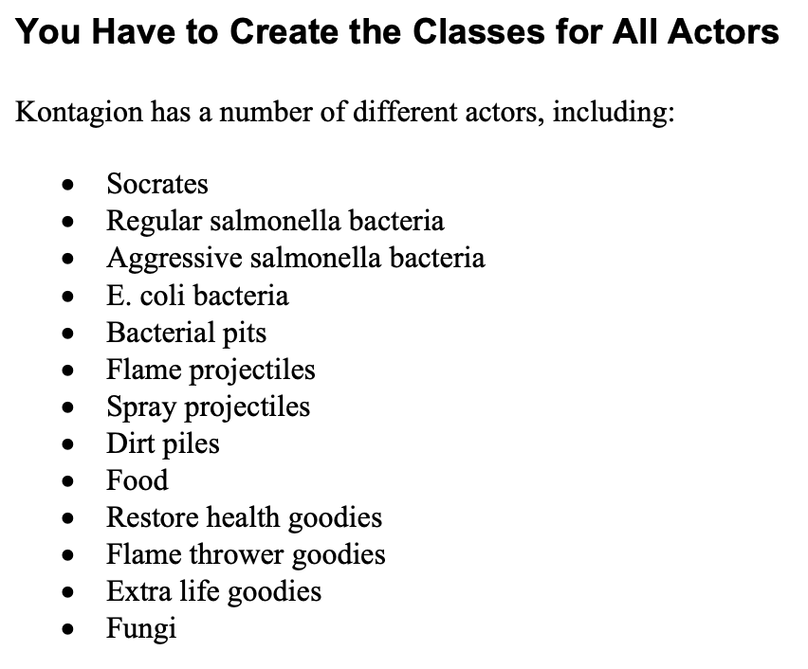
Polymorphism and Inheritance: From the Spec
Page 21
wow maybe i should make a Goodie class and derive from it

Slide 30
Miscellaneous Topics
that may be helpful for beyond Part 1

Slide 31
Generate Random Numbers
In GameConstants.h:
// Return a uniformly distributed random int
// from min to max, inclusive
int randInt(int min, int max)
{
...
implementation provided for you already
...
return a random number;
}

Slide 32
Stringstreams (for game status text)
#include <iostream>
#include <sstream>
#include <iomanip>
ostringstream oss;
int n = 123;
oss << setw(5) << k << endl;
oss.fill(‘*’); // change fill from ‘ ’ to ‘*’
oss << setw(6) << k << endl;
string s = oss.str(); // s contains “ 123\n***123\n”

Slide 33
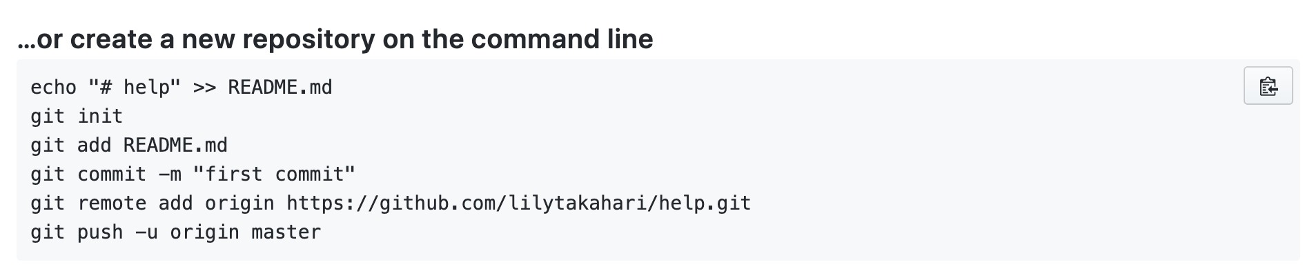
Github: Backing Up Code
You could use Github as a fancy Google Docs by copying and pasting all your files
Or you could create a local git repository and push it to Github by typing a few lines into Terminal/PuTTY/command line
Steps:
Download Git: https://git-scm.com/book/en/v2/Getting-Started-Installing-Git
For Mac: You most likely already have it installed if you have Xcode
Create a new repository on your Github account.
You will probably see a screen with info like this:

Slide 34
Github: Backing Up Code
4. In Terminal/PuTTY, cd (change directory) to the folder where all your source code is
e.g. cd ~/Documents/Winter_2020/Kontagion/Kontagion
5. Initialize a new git repository: git init
6. Add all the files in the folder to the repository:
git add .
7. Commit them to the repo. MUST include a message/string after -m:
git commit -m "first commit"
8. From the screen on GitHub, enter the command that starts with git remote add:
e.g. git remote add origin https://github.com/lilytakahari/help.git
9. Push your code to the web:
git push -u origin master
Repeat steps 6, 7, and 9 everytime you want to backup your code to Github.

Slide 35
Useful Pages for Part 1
48: Don’t know how or where to start? Read this!
6: Game Details
44: Object-Oriented Programming Tips
50: What to Turn In, Part #1
14: StudentWorld description
21: Actors description
25: Socrates
28: Dirt Pile
9: Determining Object Overlap
49: Building the Game

Slide 36
Good luck!
Sign-in https://bit.ly/39sW7vD
Slides https://bit.ly/3busBHz
Practice https://github.com/uclaupe-tutoring/practice-problems/wiki
Questions? Need more help?
Come up and ask us! We'll try our best.
UPE offers daily computer science tutoring:
Location: ACM/UPE Clubhouse (Boelter 2763)
Schedule: https://upe.seas.ucla.edu/tutoring/
You can also post on the Facebook event page.

